Slide 1
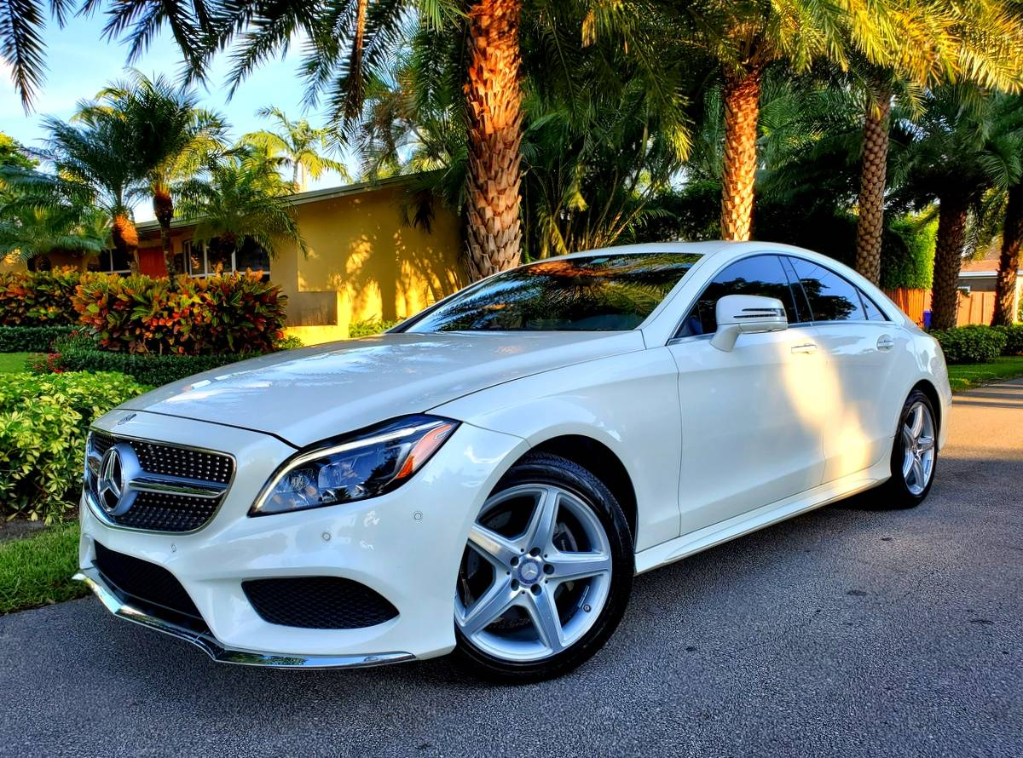

About us
Policy
Sign up
Log in
Rent a car Now…
Enjoy your drive experience !

Slide 2

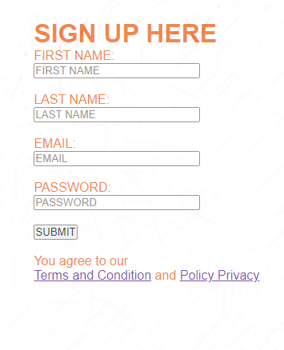
submit

Slide 3

Login
Cancel

Slide 4
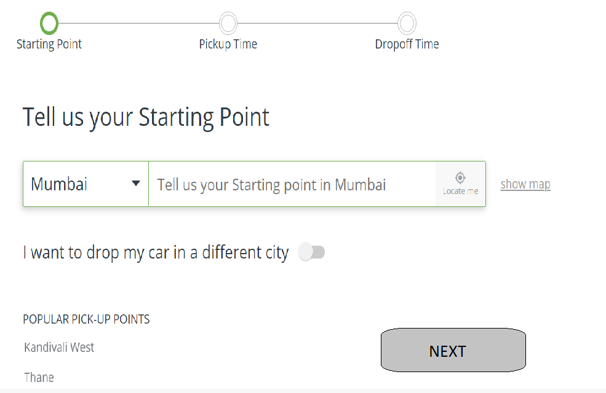
Next

Slide 5
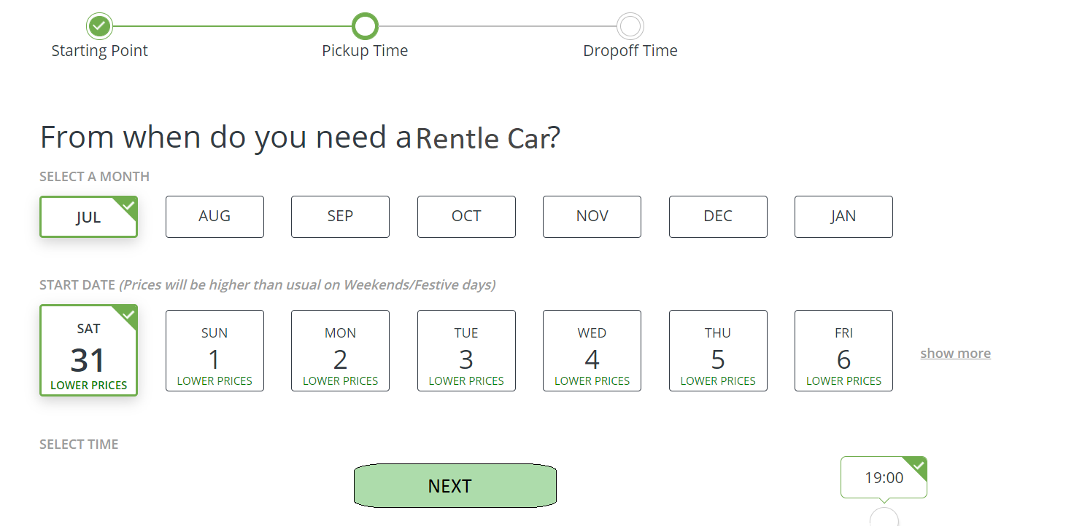
Next

Slide 6
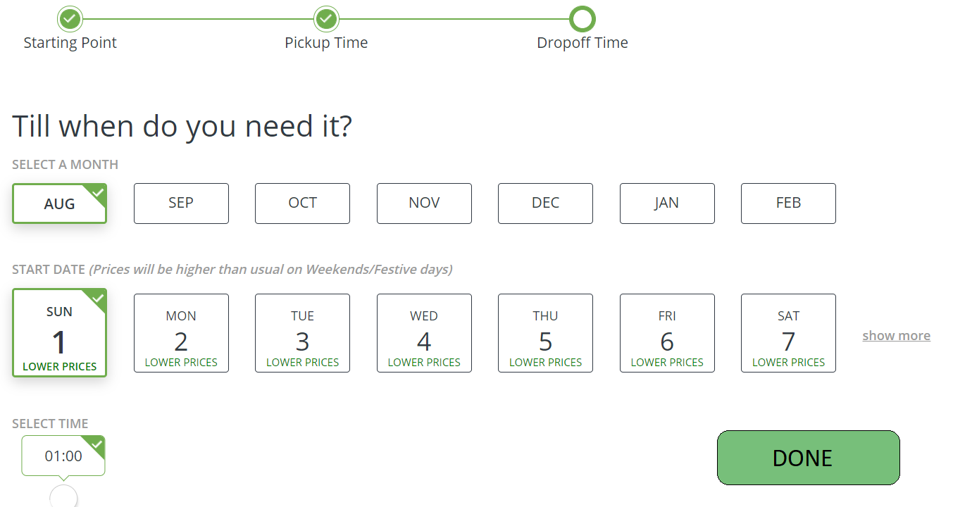
Done

Slide 7

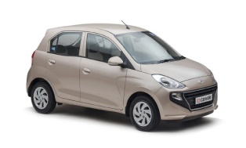

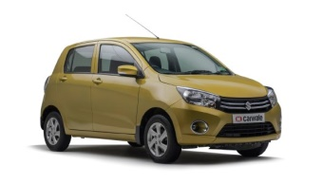
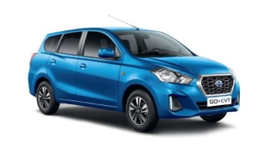
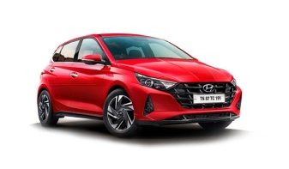


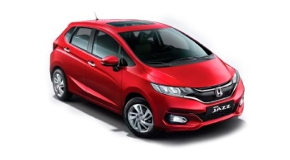
Select Your car Wisely
Hyundai Santo
maruti suzuki Alto,
Maruti Suzuki Celerio
Datsun GO+
₹15.00/km
₹18.00/km
₹21.00/km
₹22.00/km
Book Now
Book Now
Book Now
Book Now
Datsun GO
Renault Duster
Tata Tiago
Honda Jazz
₹20.00/km
₹20.00/km
₹19.00/km
₹20.00/km
Book Now
Book Now
Book Now
Book Now

Slide 8
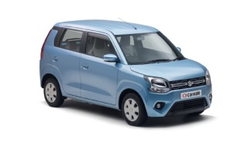


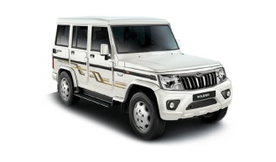




Select Your car Wisely
Wagner
Ford Figo
Skoda Rapid TSI
Mahindra Bulero
₹16.00/km
₹18.00/km
₹16.00/km
₹16.50/km
Book Now
Book Now
Book Now
Book Now
mahindra Scorpio
Maruti Suzuki swift
Tata Tiago
Maruti suzuki Beleno
₹19.00/km
₹15.00/km
₹16.00/km
₹20.00/km
Book Now
Book Now
Book Now
Book Now

Slide 9
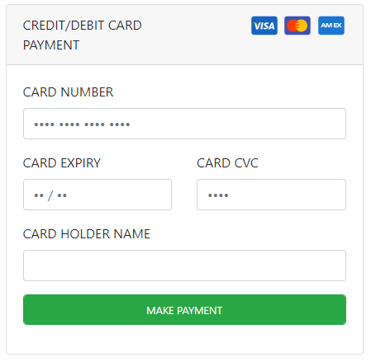
Make your Payment
Select your Payment Method
v
UPI
Credit card
Debit/ATM card
Net Banking
make payment

Slide 10
Payment
Successful
˩
Continue
Enjoy your ride!!

